Slide 1
Finding Right place to Rent in Toronto Customer Preference Based Predictor
By Nataraj Chandrasekaran

Slide 2
INTRODUCTION:-
Business Problem - An athlete and sports enthusiast student is shifting from his home country to Toronto for higher studies so as result he/she is searching for home to rent near places where sports/fitness areas are located in close proximity. For this reason he has contacted a real estate agent to ease out his work. This project will recommend the areas to the real estate agent where he/she can allocate a home for rent to the student. This project will help the real estate agent in providing better quality of service by allocating proper homes for rent to its customer.
Target Audience - Sports enthusiast students looking for home to rent.

Slide 3
DATA COLLECTION:-
Toronto Postal Code and Neighbourhood data are collected from from the wiki page - https://en.wikipedia.org/wiki/List_of_postal_codes_of_Canada:_M
'Geospatial_Coordinates.csv' is imported and merged with the Neighbourhood data for further processing
Foursquare Data is collected with help of API

Slide 4
METHODOLOGY:-
Python Libraries Used:
Pandas and Numpy for Data Analysis
Wikipedia for extracting data from Wikipedia Page
Geopy to extract Geo Coordinates from an address
Sklearn to use K-Means Clustering
Matplotlib and Folium for Data Visualization

Slide 5
Data Wrangling and Exploratory Analysis
Neighbourhood data is wrangled by removing unassigned values to Borough and by renaming the columns
Geospatial coordinates data is then merged to the Neighbourhood data to generate the final dataframe

Slide 6
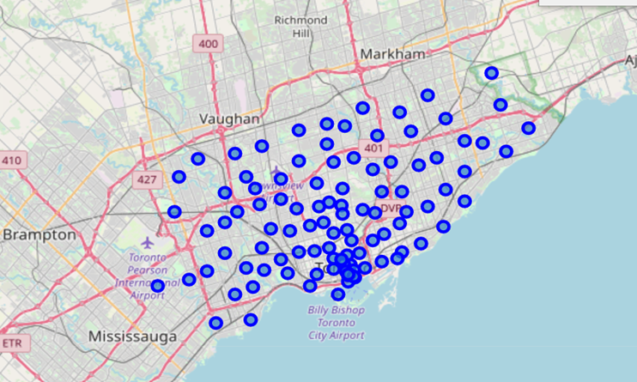
Toronto Neighbourhoods look like below:-

Slide 7
Data Wrangling and Exploratory Analysis
A function is written to call the Foursquare API and get top 100 venues in the neighborhoods in Toronto.
Each Neighborhood is analyzed by one hot encoding to produce frequency of occurence of different venues in each neighborhood
The data is grouped by Neighbourhood and filtered with only below venue categories: Park, Gym, Gym/Fitness Centres, Sporting Goods Shop, Yoga Studio, Playground, Trail, Baseball Field, Athletics & Sports, Pool, Basketball Stadium, Hockey Arena, Baseball Stadium, Skate Park, Soccer Field and Stadium.

Slide 8
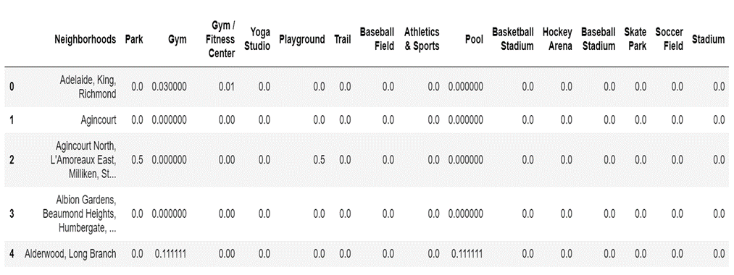
GROUP data

Slide 9
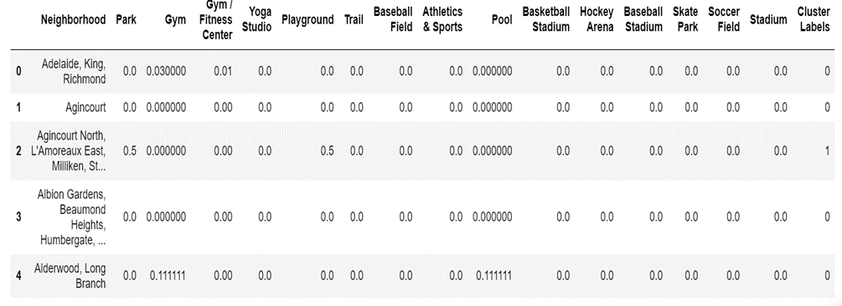
K-means Clustering
A K-Means clustering with 3 clusters have been performed.
Cluster labels are added to the dataframe.

Slide 10
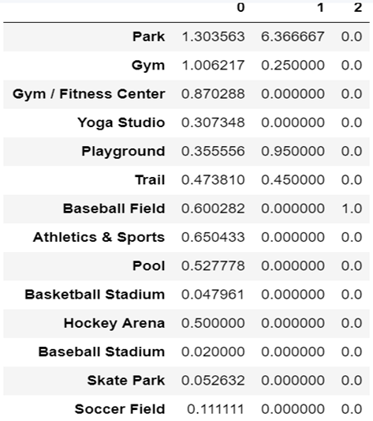
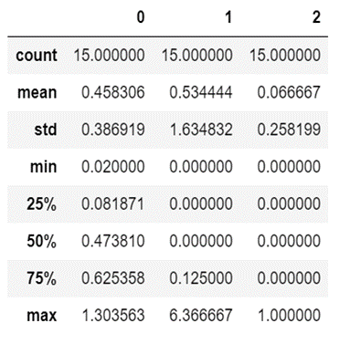
sum of occurrences of each sporting venue in each cluster and statistics of the clusters

Slide 11
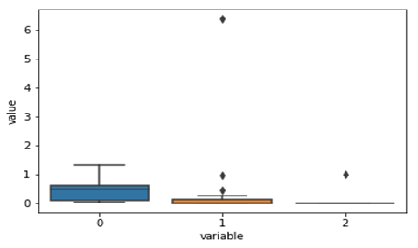
Data Visualization
The below box plot chart shows that wide variation and frequency of Sporting Venues are present in Cluster 0.

Slide 12
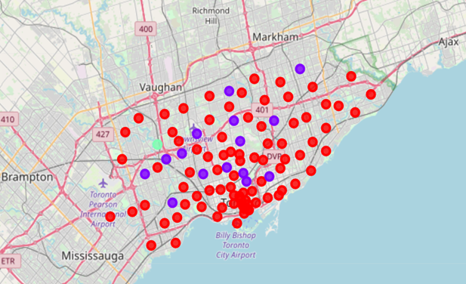
Data Visualization
The Neighbourhood clusters in the map of Toronto has been plotted with help of matplotlib and folium.
Red dots belong to cluster 0.
Blue dots belong to cluster 1.
Green dots belong to cluster 2.

Slide 13
Recommendation and conclusion
As per our initial assumption, the real estate agent would like to recommend an area where there are Sporting related venues in close proximity. As per our analysis, Cluster 0 could be recommended. However, there are several neighbourhoods in cluster 0. In order to recommend top 5 neighbourhoods, below steps are performed.
The dataframe was sorted based on maximum types and maximum count of venues
The top 5 Neighbourhoods are recommended to open the store
Business Reply Mail Processing Centre 969 Eastern (Cluster 0)
Rosedale (Cluster 1)
Moore Park, Summerhill East (Cluster 1)
Thorncliffe Park (Cluster 0)
Queen's Park (Cluster 0)

Slide 14
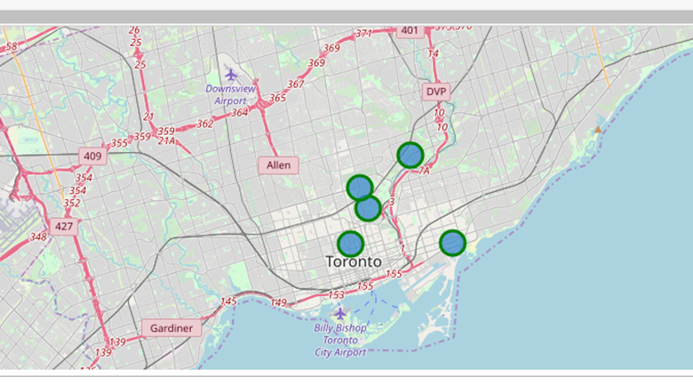
The top 5 recommended neighbourhoods

Slide 15
Thank you

